Slide 1

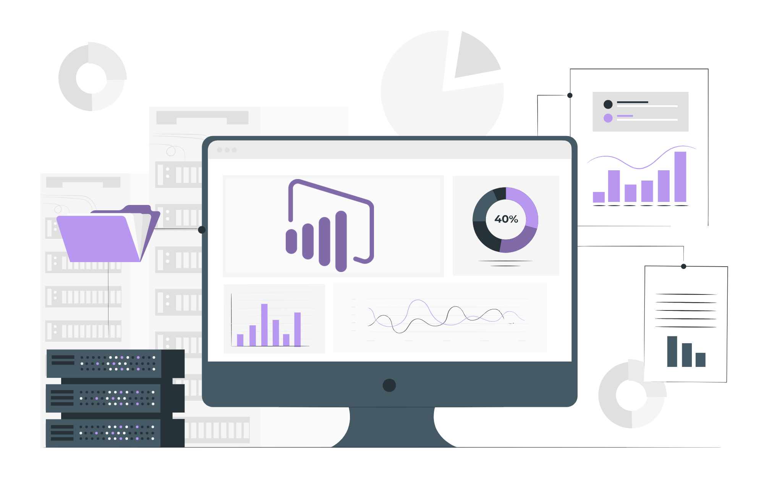
Communication Skills

Slide 2
Agenda
What is Communication
Types of Communication
Types of Communication Barriers
How to Improve Communication
Importance of Communication

Slide 3
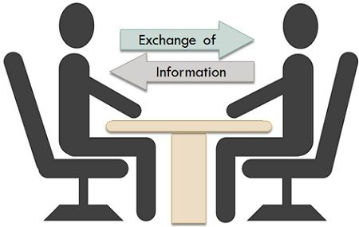
What is Communication?
Communication is the process of exchanging information, ideas, thoughts, and feelings between individuals or groups through a common system of symbols, signs, or behaviors. It involves the sender transmitting a message to a receiver, who interprets and responds to the message.

Slide 4
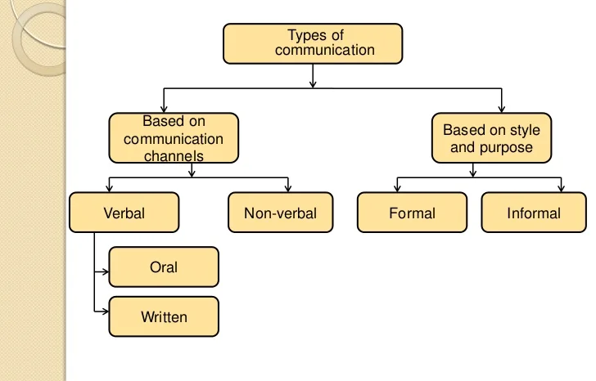
Types of Communication

Slide 5
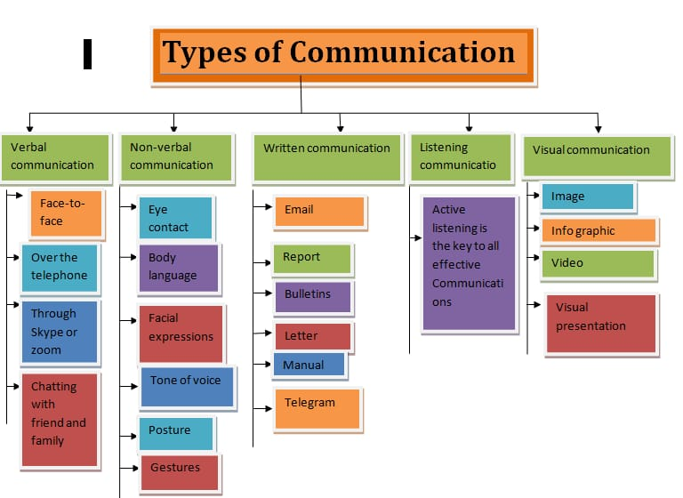

Slide 6
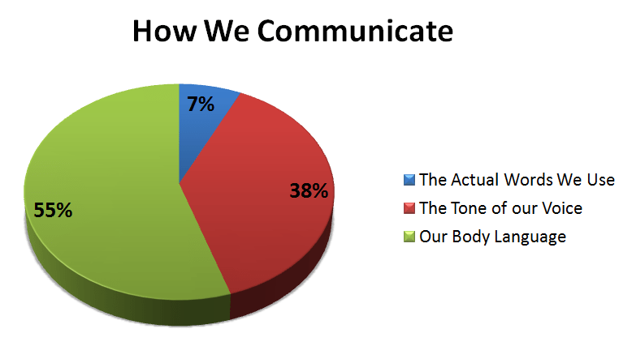
Do you know how important is HOW you speak something, rather than WHAT you speak?

Slide 7

Let’s watch this video together.
Make notes of the barriers to communication.

Slide 8

Notes:
https://youtu.be/8Ox5LhIJSBE

Slide 9
What were some barriers to communication that you noticed?

Slide 10
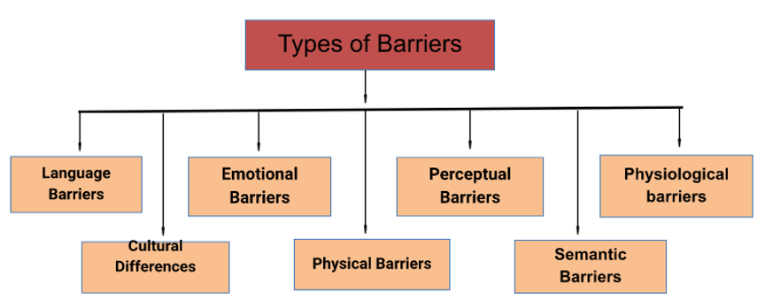
Types Of COMMUNICATION BARRIERS

Slide 11
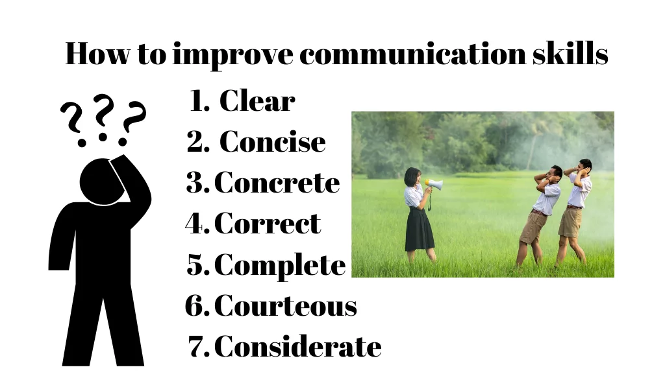
Notes:
Business and Finance:
Market analysis
Customer segmentation
Credit risk assessment
Fraud detection
Investment portfolio management
Financial forecasting
Healthcare:
Disease diagnosis
Drug discovery
Patient outcomes analysis
Healthcare resource optimization
Epidemiological studies
Retail and E-Commerce:
Sales and inventory optimization
Customer behavior analysis
Personalized marketing
Supply chain management
Price optimization
Government and Public Policy:
Public policy analysis
Crime pattern recognition
Social program effectiveness
Traffic and transportation management
Election forecasting
Energy and Utilities:
Energy consumption optimization
Predictive maintenance of infrastructure
Renewable energy resource management
Grid management
Marketing and Advertising:
Ad campaign performance analysis
Social media analytics
Customer sentiment analysis
Click-through rate prediction
A/B testing
Manufacturing and Supply Chain:
Quality control and defect detection
Inventory management
Production process optimization
Supplier relationship management
Telecommunications:
Network performance monitoring
Customer churn prediction
Service quality improvement
Infrastructure optimization
Education:
Student performance analysis
Adaptive learning systems
Educational program assessment
Resource allocation
Transportation and Logistics:
Route optimization
Demand forecasting
Fleet management
Delivery scheduling
Entertainment and Media:
Content recommendation
Audience engagement analysis
Box office predictions
User behavior modeling
Environmental Science:
Climate change analysis
Natural disaster prediction and response
Ecosystem monitoring
Conservation efforts
Human Resources:
Employee performance analysis
Workforce planning
Recruitment and talent acquisition
Employee satisfaction surveys
Sports Analytics:
Player performance analysis
Game strategy optimization
Fan engagement
Athlete injury prevention
Supply Chain Management:
Demand forecasting
Inventory optimization
Supplier performance analysis
Logistics and distribution management
Social Services:
Child welfare and protection
Homelessness prevention
Elderly care optimization
Social program evaluation
Agriculture:
Crop yield prediction
Pest and disease detection
Precision farming
Irrigation management
Sustainability and Environmental Conservation:
Sustainable resource management
Pollution monitoring and control
Wildlife conservation efforts
These are just a few examples of the diverse domains in which data analytics plays a critical role in improving decision-making, efficiency, and outcomes. The applications of data analytics continue to grow as more organizations recognize its value in harnessing the power of data.

Slide 12
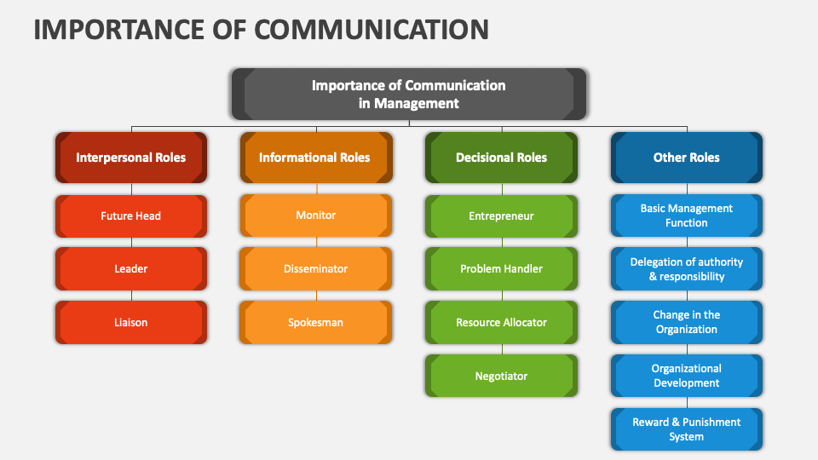
Notes:
Business and Finance:
Market analysis
Customer segmentation
Credit risk assessment
Fraud detection
Investment portfolio management
Financial forecasting
Healthcare:
Disease diagnosis
Drug discovery
Patient outcomes analysis
Healthcare resource optimization
Epidemiological studies
Retail and E-Commerce:
Sales and inventory optimization
Customer behavior analysis
Personalized marketing
Supply chain management
Price optimization
Government and Public Policy:
Public policy analysis
Crime pattern recognition
Social program effectiveness
Traffic and transportation management
Election forecasting
Energy and Utilities:
Energy consumption optimization
Predictive maintenance of infrastructure
Renewable energy resource management
Grid management
Marketing and Advertising:
Ad campaign performance analysis
Social media analytics
Customer sentiment analysis
Click-through rate prediction
A/B testing
Manufacturing and Supply Chain:
Quality control and defect detection
Inventory management
Production process optimization
Supplier relationship management
Telecommunications:
Network performance monitoring
Customer churn prediction
Service quality improvement
Infrastructure optimization
Education:
Student performance analysis
Adaptive learning systems
Educational program assessment
Resource allocation
Transportation and Logistics:
Route optimization
Demand forecasting
Fleet management
Delivery scheduling
Entertainment and Media:
Content recommendation
Audience engagement analysis
Box office predictions
User behavior modeling
Environmental Science:
Climate change analysis
Natural disaster prediction and response
Ecosystem monitoring
Conservation efforts
Human Resources:
Employee performance analysis
Workforce planning
Recruitment and talent acquisition
Employee satisfaction surveys
Sports Analytics:
Player performance analysis
Game strategy optimization
Fan engagement
Athlete injury prevention
Supply Chain Management:
Demand forecasting
Inventory optimization
Supplier performance analysis
Logistics and distribution management
Social Services:
Child welfare and protection
Homelessness prevention
Elderly care optimization
Social program evaluation
Agriculture:
Crop yield prediction
Pest and disease detection
Precision farming
Irrigation management
Sustainability and Environmental Conservation:
Sustainable resource management
Pollution monitoring and control
Wildlife conservation efforts
These are just a few examples of the diverse domains in which data analytics plays a critical role in improving decision-making, efficiency, and outcomes. The applications of data analytics continue to grow as more organizations recognize its value in harnessing the power of data.

Slide 13
Basic HR Questions:
Tell me about yourself ?
What are your strength and weaknesses ?
Where do you see yourself in five years ?
How do you handle stress and pressure ?
Describe a challenging situation and how you handled it ?
Why did you leave your last ?
What are your salary expectations ?
Notes:
Business and Finance:
Market analysis
Customer segmentation
Credit risk assessment
Fraud detection
Investment portfolio management
Financial forecasting
Healthcare:
Disease diagnosis
Drug discovery
Patient outcomes analysis
Healthcare resource optimization
Epidemiological studies
Retail and E-Commerce:
Sales and inventory optimization
Customer behavior analysis
Personalized marketing
Supply chain management
Price optimization
Government and Public Policy:
Public policy analysis
Crime pattern recognition
Social program effectiveness
Traffic and transportation management
Election forecasting
Energy and Utilities:
Energy consumption optimization
Predictive maintenance of infrastructure
Renewable energy resource management
Grid management
Marketing and Advertising:
Ad campaign performance analysis
Social media analytics
Customer sentiment analysis
Click-through rate prediction
A/B testing
Manufacturing and Supply Chain:
Quality control and defect detection
Inventory management
Production process optimization
Supplier relationship management
Telecommunications:
Network performance monitoring
Customer churn prediction
Service quality improvement
Infrastructure optimization
Education:
Student performance analysis
Adaptive learning systems
Educational program assessment
Resource allocation
Transportation and Logistics:
Route optimization
Demand forecasting
Fleet management
Delivery scheduling
Entertainment and Media:
Content recommendation
Audience engagement analysis
Box office predictions
User behavior modeling
Environmental Science:
Climate change analysis
Natural disaster prediction and response
Ecosystem monitoring
Conservation efforts
Human Resources:
Employee performance analysis
Workforce planning
Recruitment and talent acquisition
Employee satisfaction surveys
Sports Analytics:
Player performance analysis
Game strategy optimization
Fan engagement
Athlete injury prevention
Supply Chain Management:
Demand forecasting
Inventory optimization
Supplier performance analysis
Logistics and distribution management
Social Services:
Child welfare and protection
Homelessness prevention
Elderly care optimization
Social program evaluation
Agriculture:
Crop yield prediction
Pest and disease detection
Precision farming
Irrigation management
Sustainability and Environmental Conservation:
Sustainable resource management
Pollution monitoring and control
Wildlife conservation efforts
These are just a few examples of the diverse domains in which data analytics plays a critical role in improving decision-making, efficiency, and outcomes. The applications of data analytics continue to grow as more organizations recognize its value in harnessing the power of data.

Slide 14
GD Topics
Impact of social media on society.
Work from home : Pros and Cons.
Artificial intelligence: Boon or bane?
The impact of fitness and wellness trends on health.
The importance of soft skills in professional success.
Notes:
Business and Finance:
Market analysis
Customer segmentation
Credit risk assessment
Fraud detection
Investment portfolio management
Financial forecasting
Healthcare:
Disease diagnosis
Drug discovery
Patient outcomes analysis
Healthcare resource optimization
Epidemiological studies
Retail and E-Commerce:
Sales and inventory optimization
Customer behavior analysis
Personalized marketing
Supply chain management
Price optimization
Government and Public Policy:
Public policy analysis
Crime pattern recognition
Social program effectiveness
Traffic and transportation management
Election forecasting
Energy and Utilities:
Energy consumption optimization
Predictive maintenance of infrastructure
Renewable energy resource management
Grid management
Marketing and Advertising:
Ad campaign performance analysis
Social media analytics
Customer sentiment analysis
Click-through rate prediction
A/B testing
Manufacturing and Supply Chain:
Quality control and defect detection
Inventory management
Production process optimization
Supplier relationship management
Telecommunications:
Network performance monitoring
Customer churn prediction
Service quality improvement
Infrastructure optimization
Education:
Student performance analysis
Adaptive learning systems
Educational program assessment
Resource allocation
Transportation and Logistics:
Route optimization
Demand forecasting
Fleet management
Delivery scheduling
Entertainment and Media:
Content recommendation
Audience engagement analysis
Box office predictions
User behavior modeling
Environmental Science:
Climate change analysis
Natural disaster prediction and response
Ecosystem monitoring
Conservation efforts
Human Resources:
Employee performance analysis
Workforce planning
Recruitment and talent acquisition
Employee satisfaction surveys
Sports Analytics:
Player performance analysis
Game strategy optimization
Fan engagement
Athlete injury prevention
Supply Chain Management:
Demand forecasting
Inventory optimization
Supplier performance analysis
Logistics and distribution management
Social Services:
Child welfare and protection
Homelessness prevention
Elderly care optimization
Social program evaluation
Agriculture:
Crop yield prediction
Pest and disease detection
Precision farming
Irrigation management
Sustainability and Environmental Conservation:
Sustainable resource management
Pollution monitoring and control
Wildlife conservation efforts
These are just a few examples of the diverse domains in which data analytics plays a critical role in improving decision-making, efficiency, and outcomes. The applications of data analytics continue to grow as more organizations recognize its value in harnessing the power of data.

Slide 15

Q & A
Ask your questions

Slide 16
THANK YOU

